Slide 1
A Guide to AHEPA Online Membership Presented by Rosalind N. Ofuokwu, MBA-Director of Membership
Review of key functions to navigate the membership website.
You will learn how to:
Sign-on as first-time user
Manage personal account
Manage chapter/member account (for chapter officers only)
Download reports (for officers use only)
Chapter dues payment (for chapter officers only)

Slide 2
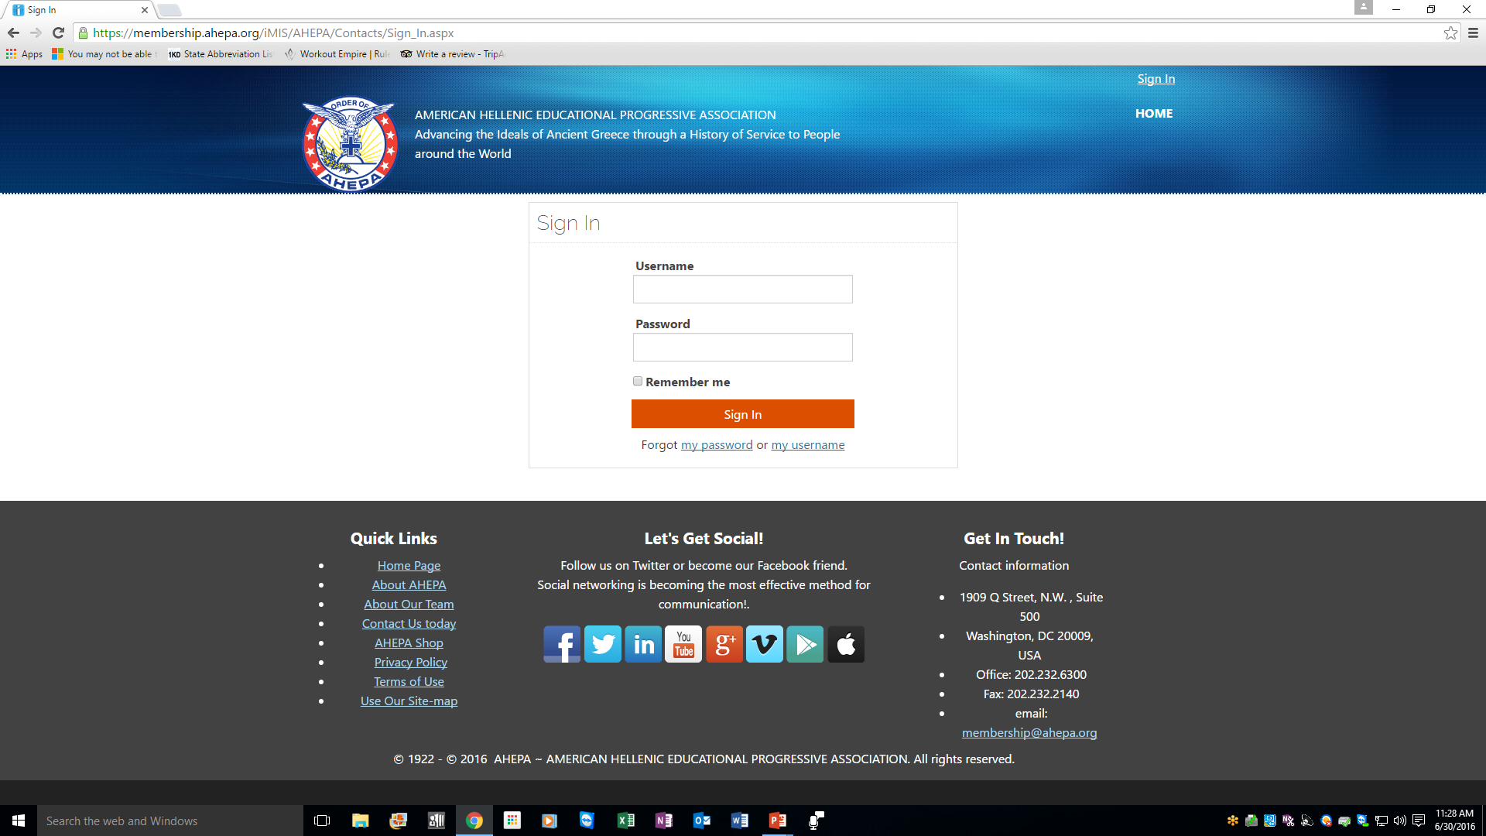
Q. Where do I find the link for the Online Membership
Open a web browser (Chrome, Internet Explorer, Microsoft Edge, Mozilla Firefox)
Go to www.ahepa.org >>click on JOIN>>click on Enter Here
You will be routed to the Sign-in Membership Home Page – see below screen shot

Slide 3
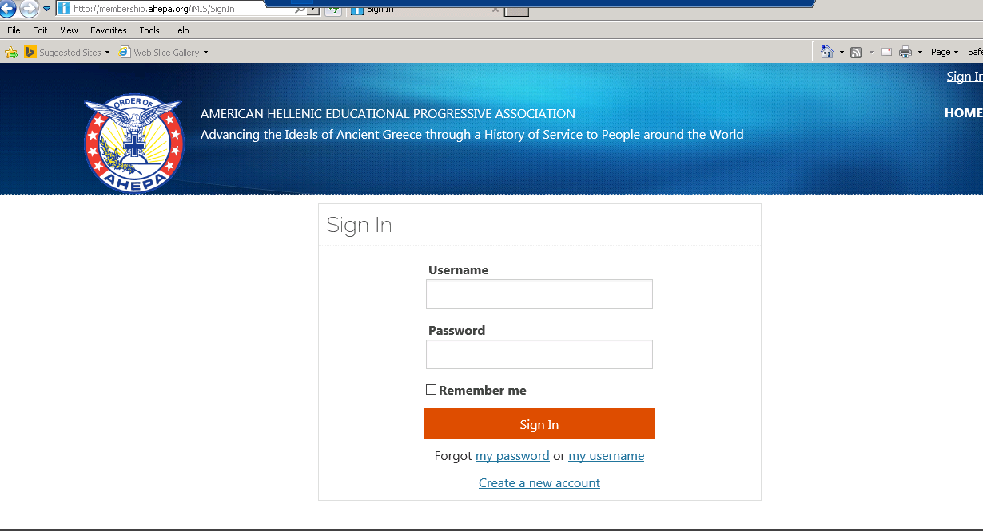
Q. How do I activate my online account
At the Sign-in home page, click the ‘Forgot my password’ link

Slide 4
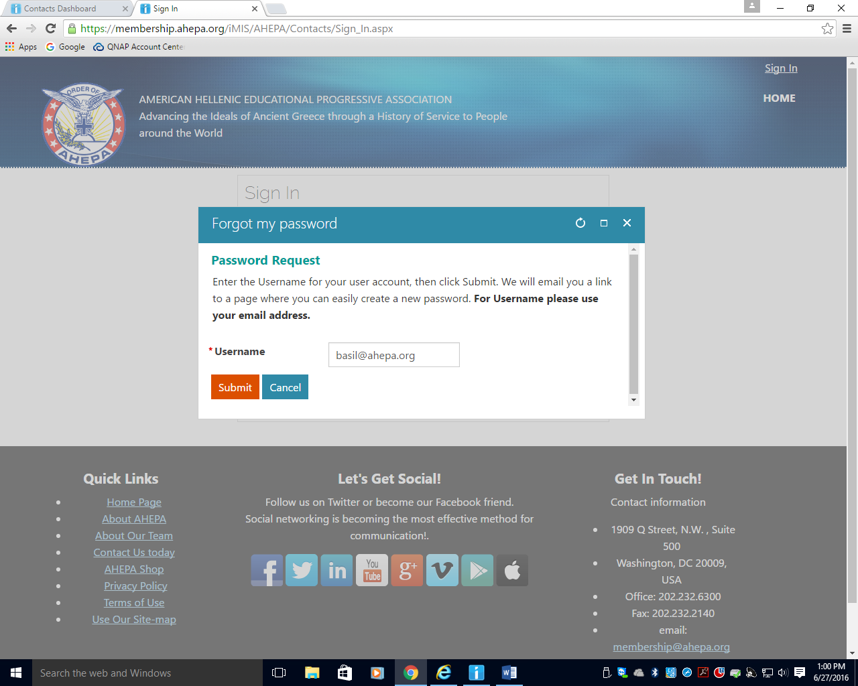
Q. How do I activate my online account
A dialog box will open up – see below
In the ‘Username’ field, type an email address and hit submit (please note, the email address is the username and it is the valid email address on file at headquarters)

Slide 5
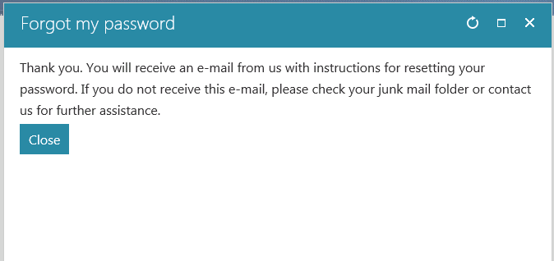
Q. How do I activate my online account
Once your email address is submitted, the system validates the address
A dialog box will open – see below, instructing members to check their inbox for instructions on resetting password. Click on close.

Slide 6
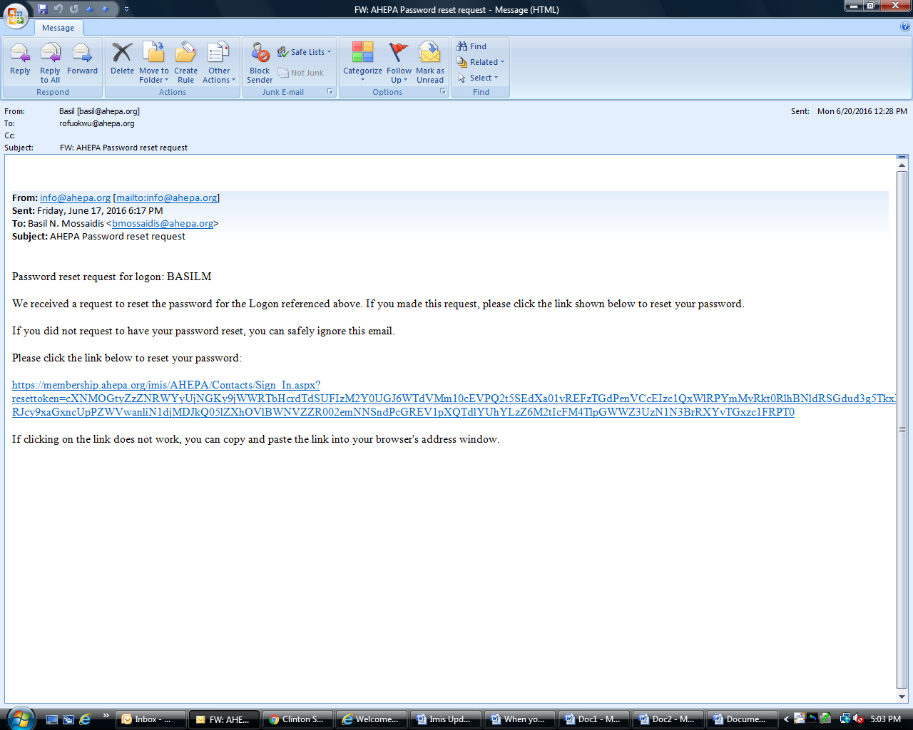
Q. How do I activate my online account
In the email instruction, click on the link to reset your password.
You will be routed to your member page.

Slide 7
Q. Unable to login (system not recognizing my email)
Please email membership@ahepa.org and provide current email address and membershipid. Once email has been updated in the system, you will receive an email to re-activate your account by going to the Sign-in home page – see below screen shot, click the ‘Forgot my password’ link (follow instruction as provided on screen)

Slide 8
Q. How will Chapter know when a member pays online
A. When a member pays dues online, headquarters will send a notification to the chapter

Slide 9
For Chapter officers: General Information on initiating/reinstating member online
For chapter whose members were initiated online, in order for membership certificates be mailed, application forms MUST be mailed to headquarters (1909 Q St., NW, Ste 500, Washington, DC 20009) OR emailed to membership@ahepa.org.

Slide 10
Q: Can Headquarters Collect Chapter Dues?
According to the IRS, we are a 501(c)(10) operating under a lodge system.
If Headquarters is to collect chapter and district dues at varied amounts, we would not be operating under a lodge system and would therefore lose our exemption as a 501(c)(10) organization.
However, if Chapters were to agree on a fixed amount for membership dues, Headquarters would be able to collect the chapter amount and issue the chapter’s portion back to the chapter.

Slide 11
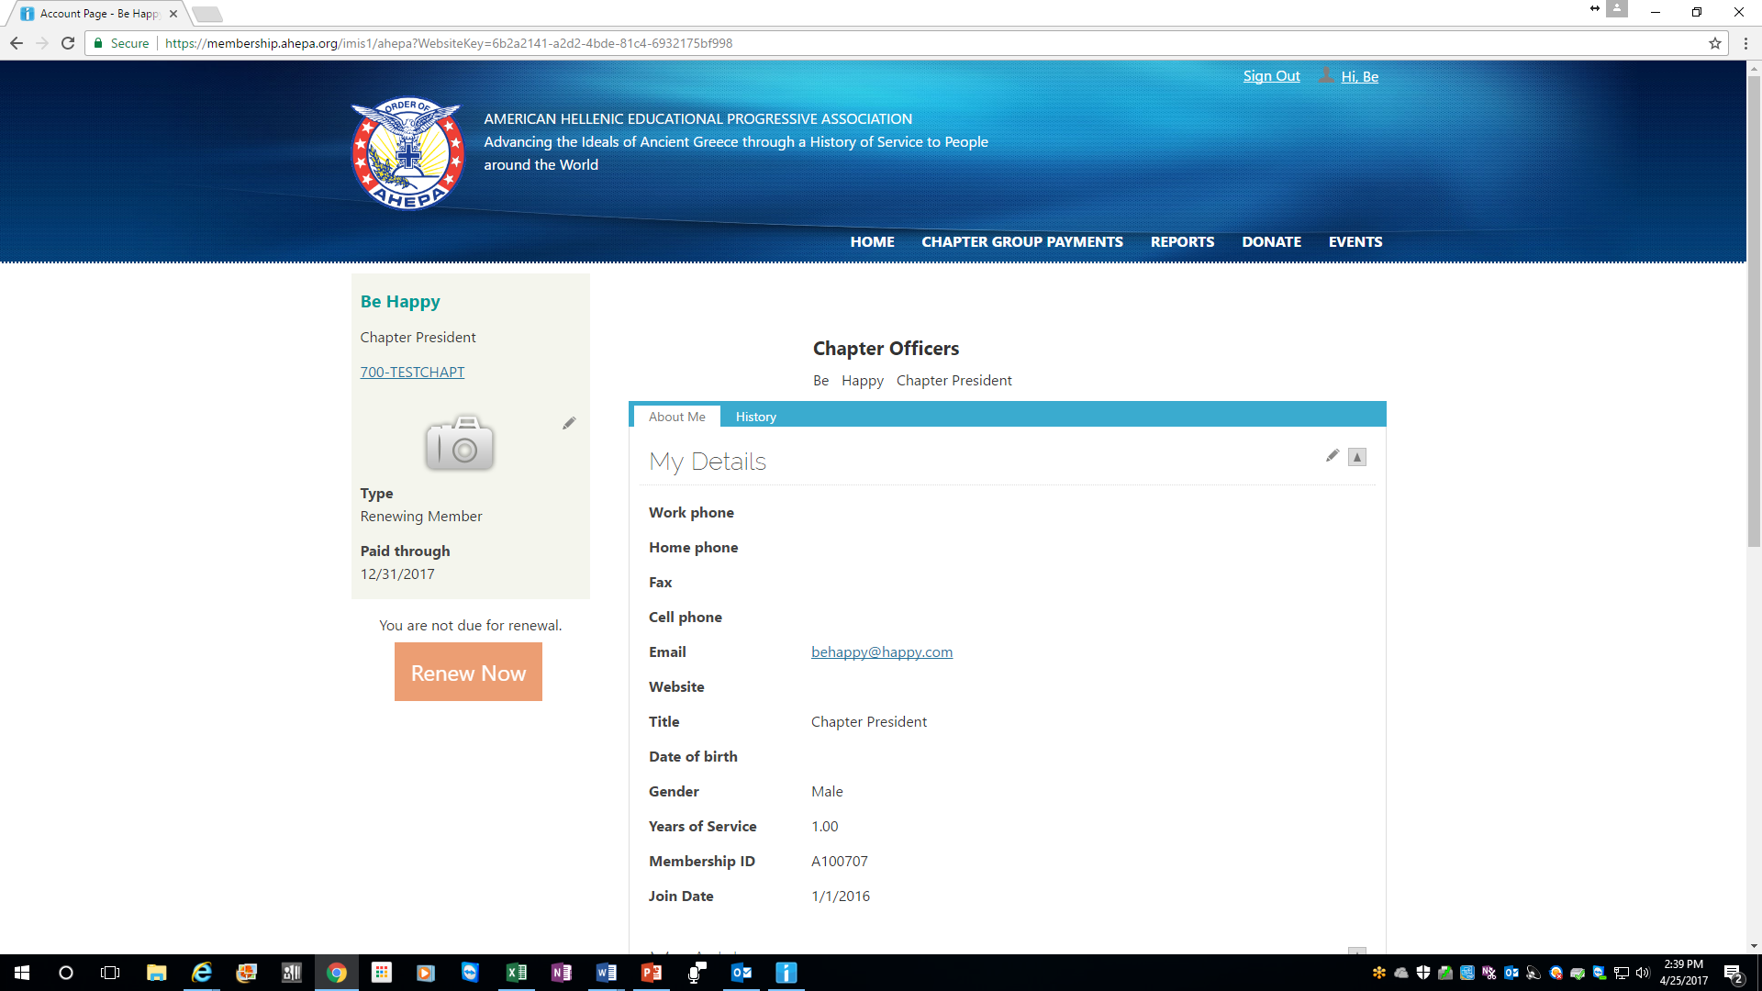
PAYMENT PAYMENT: CHAPTER OFFICER LEVEL
Step 1: If you are a chapter officer, use your username to log in to your member page
Step 2: Click on the “Chapter Group Payment” tab (example circled in red).

Slide 12
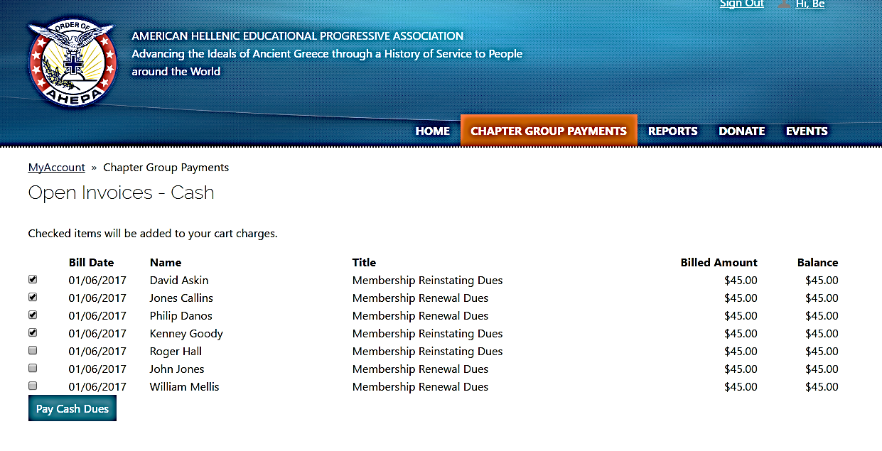
DUES PAYMENT: CHAPTER OFFICER LEVEL
Once you click on the “Chapter Group Payment” tab, the member “Payment Selection” page opens
Step 3: Select the members you are paying for by clicking on the payment box next to each member’s name.
Once selection is completed, click on “Pay Cash Dues”

Slide 13
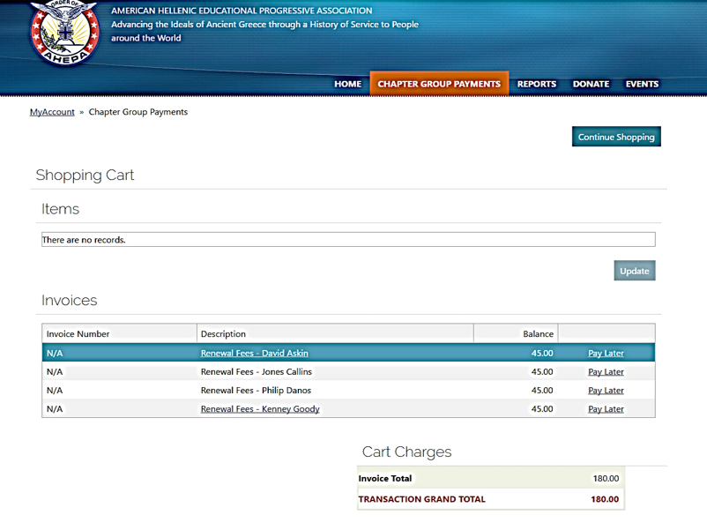
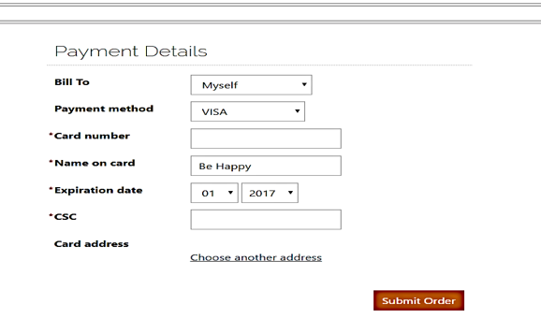
DUES PAYMENT: CHAPTER OFFICER LEVEL
Once you click on “Pay Cash Dues”, you will be routed to the shopping cart
Step 4: On the “Shopping Cart” page, you will see the list of members being paid for and the transaction total. Select “Payment Method” (Visa, MC, Disc, Amex). Click on “Submit Order” when complete.
Note: The card address entered MUST match the credit card billing address. If the card address does not match, please click on “Choose another address” to update and click “OK” when finished
FYI: The “Pay Later” link is to remove a name from the shopping cart if the officer decides not to pay prior to completing the payment process.

Slide 14
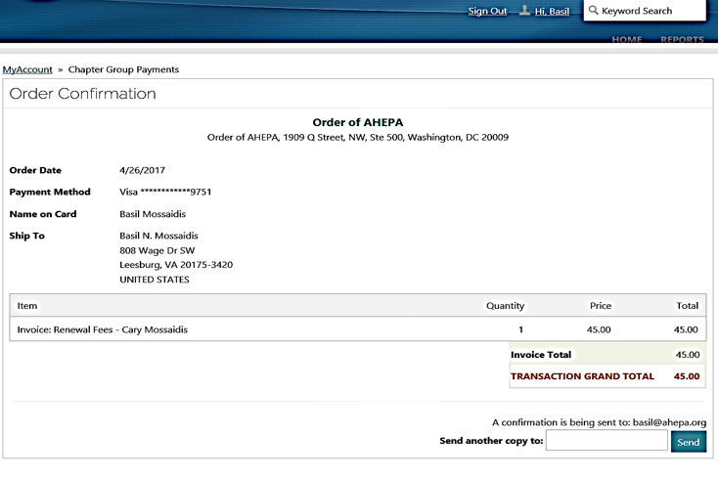
DUES PAYMENT: CHAPTER OFFICER LEVEL
Step 5: Once the ‘Submit Order” link is clicked to complete payment, an order confirmation page opens to view a receipt of your transaction.
A confirmation receipt of the transaction will be emailed to the email we currently have on file for you. You may also send the receipt to a different email address before exiting the page.
Note: If you sent a confirmation receipt to more than one email, the system will record each email sent as an entry in your financial history.

Slide 15
IMPORTANT NOTES
Officers or individual member can renew membership via credit card online. If you do not wish to pay for dues via credit card, Chapter officers must submit a check to headquarters along with chapter billing or payment list – if paying for new or reinstating member, application form must accompany dues remittance as done previously. For Individual member paying dues via online – chapter will be notified of payment
Back dues cannot be paid online. Chapter officer paying back dues (years missed) for members should remit payment to headquarters for processing.
The top four Chapter Officers have access to their chapter reports (Chapter President, Chapter Vice President, Chapter Secretary/Recording Secretary, and Chapter Treasurer).
The top four district officers have access to the chapter reports within their district.

Slide 16
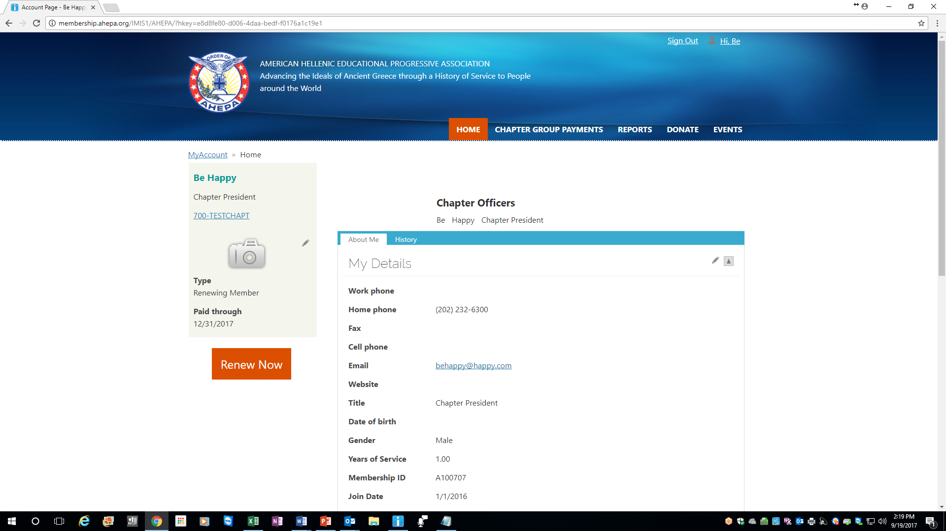
MANAGING MEMBER INFORMATION (Chapter Officers)
To manage members’ information, click on Chapter link (see arrow) on the left corner of your page

Slide 17
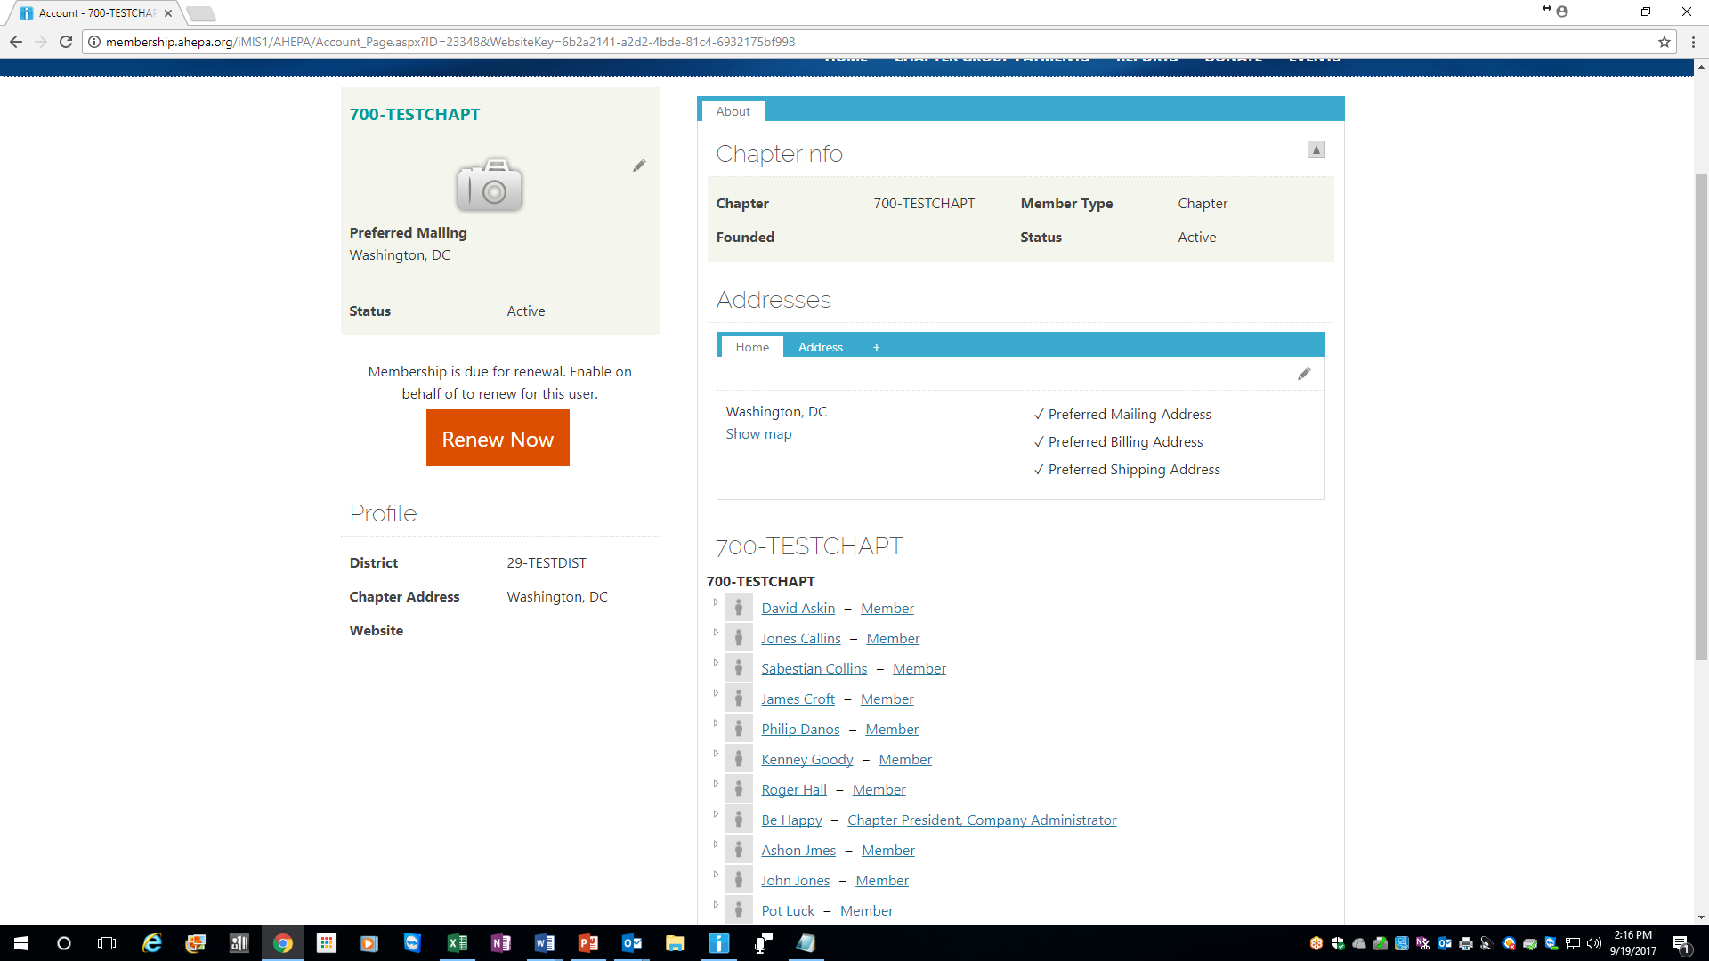
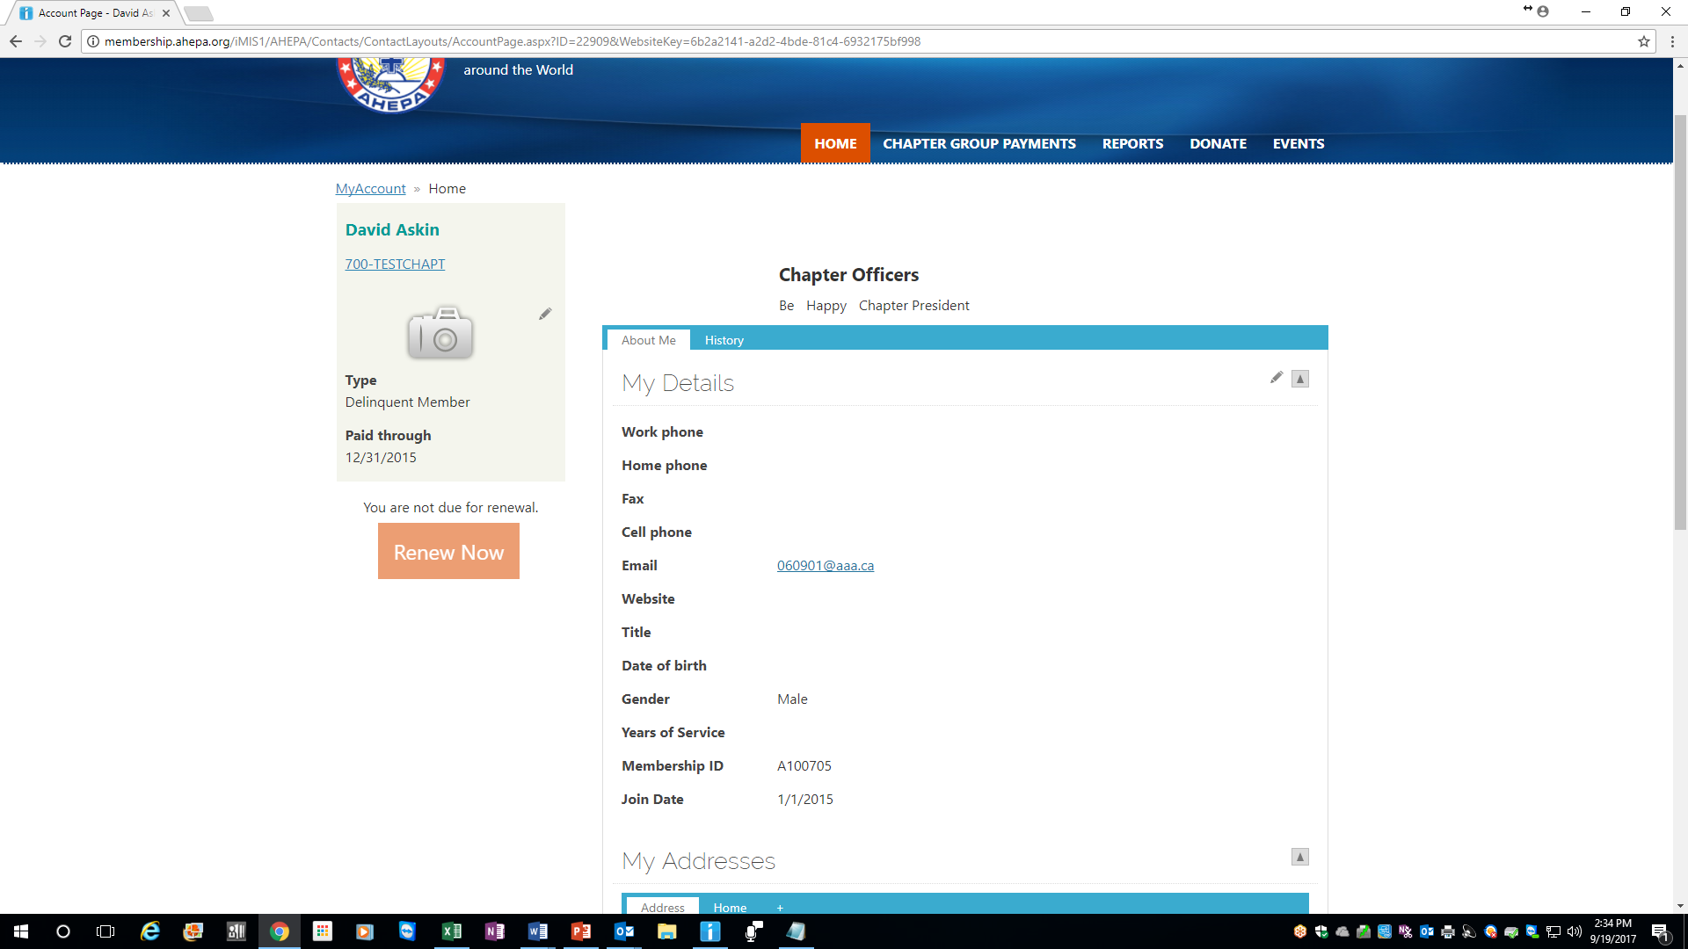
MANAGING MEMBER INFORMATION (Chapter Officers)
At the chapter page, click on the member name you wish to update contact information (see below arrow); an edit dialog box opens up; click on the edit button (looks like a pen), once update is completed click on ‘Save’ – Note: You cannot edit your Title, Date of Birth, Gender, Years of Service and Membership ID, Join Date, so these fields will be greyed out.

Slide 18
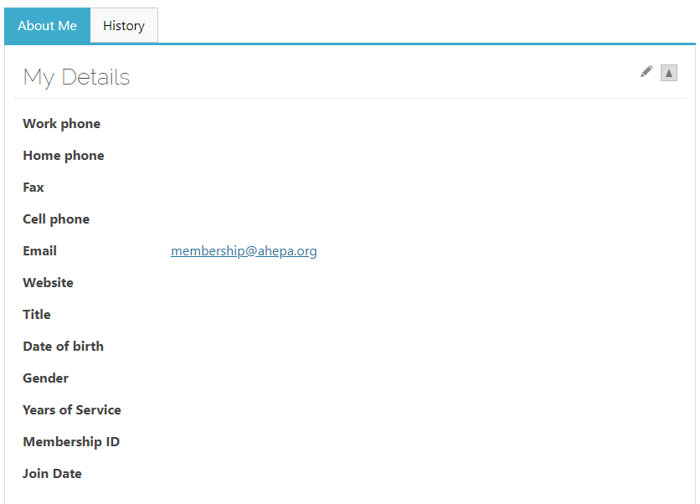
MEMBER PROFILE – ABOUT ME TAB
Under the About Me tab, click on the pen in the right hand corner (see arrow) to edit your information.
Note: You cannot edit your Title, Date of Birth, Years of Service, Membership ID or Join Date so these fields will be greyed out.

Slide 19
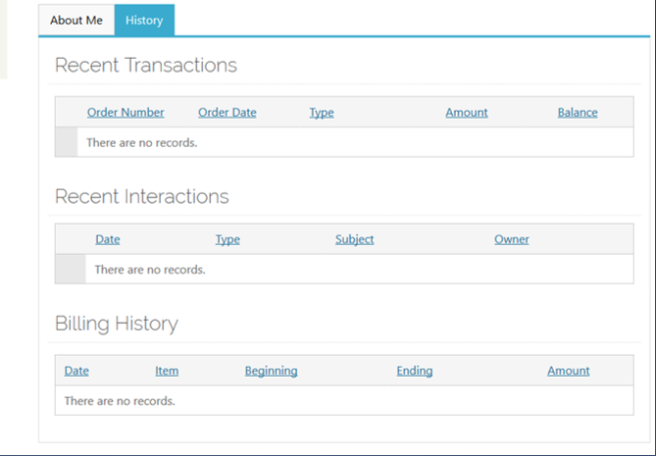
MEMBER PROFILE – HISTORY TAB
Under the History Tab, you can view recent transactions, interactions and billing history.
For example, once you pay your membership dues online or any other transaction, you will be able to view the transaction on this tab

Slide 20
REPORTS DOWNLOAD
To view/download reports, click the Reports tab in the top right corner and then click on the link labeled IQA Reports which takes you to the report page to download chapter rosters; member labels & chapter billing (Chapter Billing download for Chapter Officers only)

Slide 21
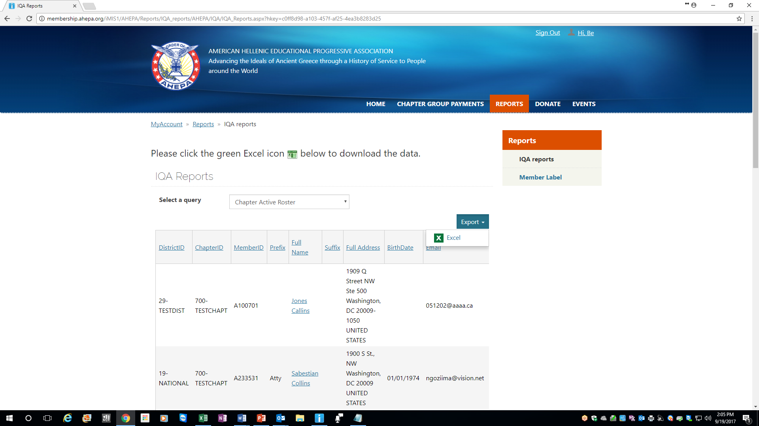
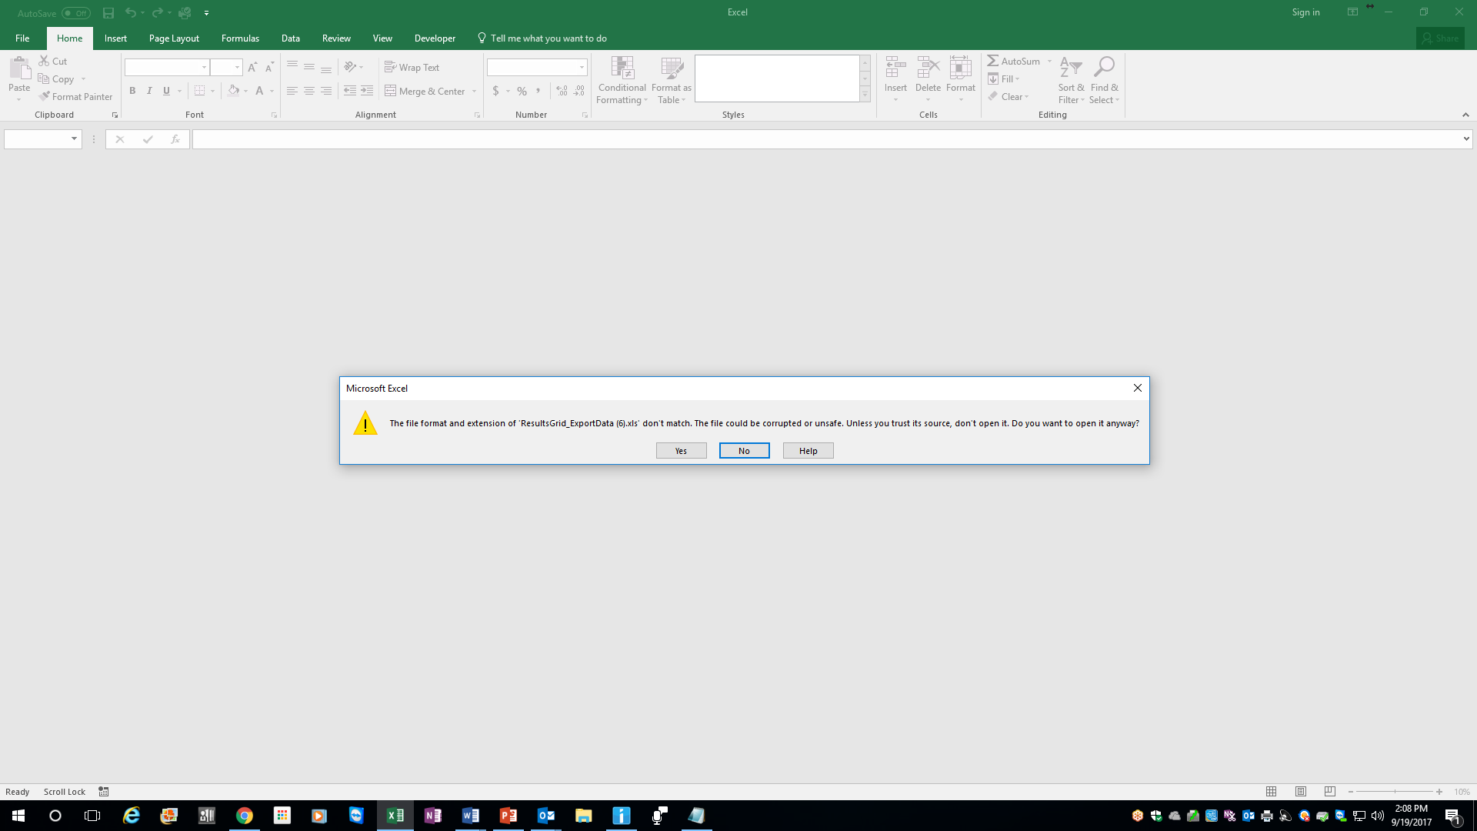
REPORTS DOWNLOAD
At the report page, the below screen will appear. Choose the reports you wish to view by selecting the report via the drop down menu where it says Select a query. Select desired report by clicking on the drop down report menu. Once the report is selected, click on Export and on the Excel icon to download the report. Once download is completed, click on the download file
Note: for District or National officers, to select by Chapter number, enter (3) characters- e.g. for chapter 1 enter 001. By District number enter (2) characters – e.g. for district 1 enter 01. For International chapters, to select by chapter (5) characters, e.g. Greece to select chapter 001, first enter for ‘HJ’ followed by the (3) chapter character (HJ001) for Canada ‘CJ’ followed by the chapter number and so forth
An excel dialog box opens (see below screen) asking if you trust the file, click “YES” to complete the download

Slide 22
REPORTS DOWNLOAD
Chapter Officers: Please note when downloading delinquent roster, select by ‘Paid Through Date’ – which is by date range – online delinquency range starts from the year 12/31/2010 – 12/31/2017

Slide 23

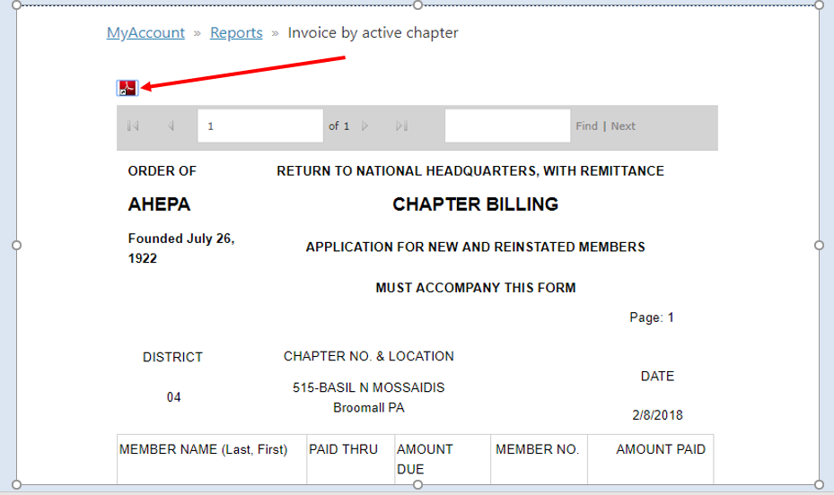
CHAPTER BILLING
To view/download chapter billing, click the Reports tab in the top right corner and then click on the link labeled Chapter Billing which takes you to the report page to download the report
To print the billing, click on the PDF icon to download for print

Slide 24
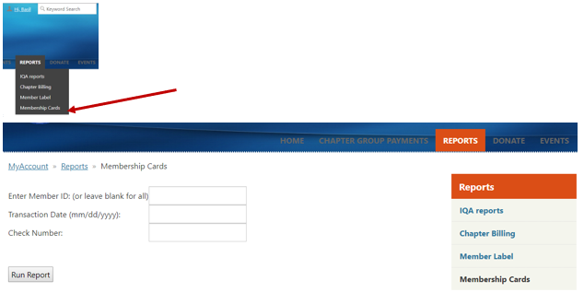

REPORTS DOWNLOAD – MEMBERSHIP CARDS
To print membership cards, click on the Reports tab on the right corner of your profile page and click on the link labeled Membership Cards
You may download cards by:
MemberID
Check Number
Transaction Date (This option is ONLY for online credit card payment)
Click Run Report.
At the membership card report page, click on the Save Icon
Click on PDF to complete download (please make sure pop-up is unblocked)

Slide 25
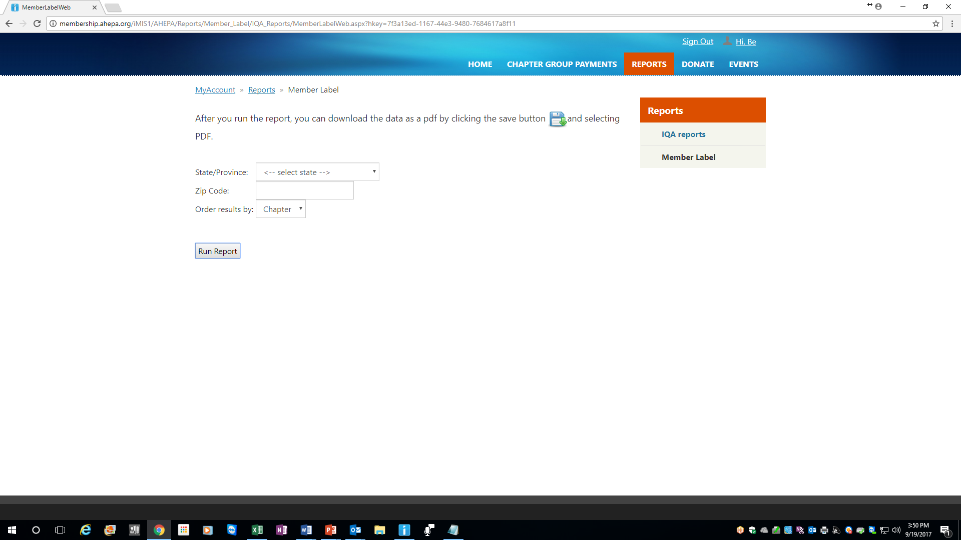
REPORTS DOWNLOAD – MEMBER LABELS
To print labels, click on the Reports tab on the right corner of your landing page and click on the link labeled Member Label and below screen appears
Note: for District or National officers, to select by Chapter number, enter (3) characters. By District number enter (2) characters. For International chapters, to select by chapter (5) characters, e.g. Greece to select chapter 001, first enter ‘HJ’ followed by the (3) chapter character (HJ001) for Canada ‘CJ’ followed by the chapter number and so forth

Slide 26
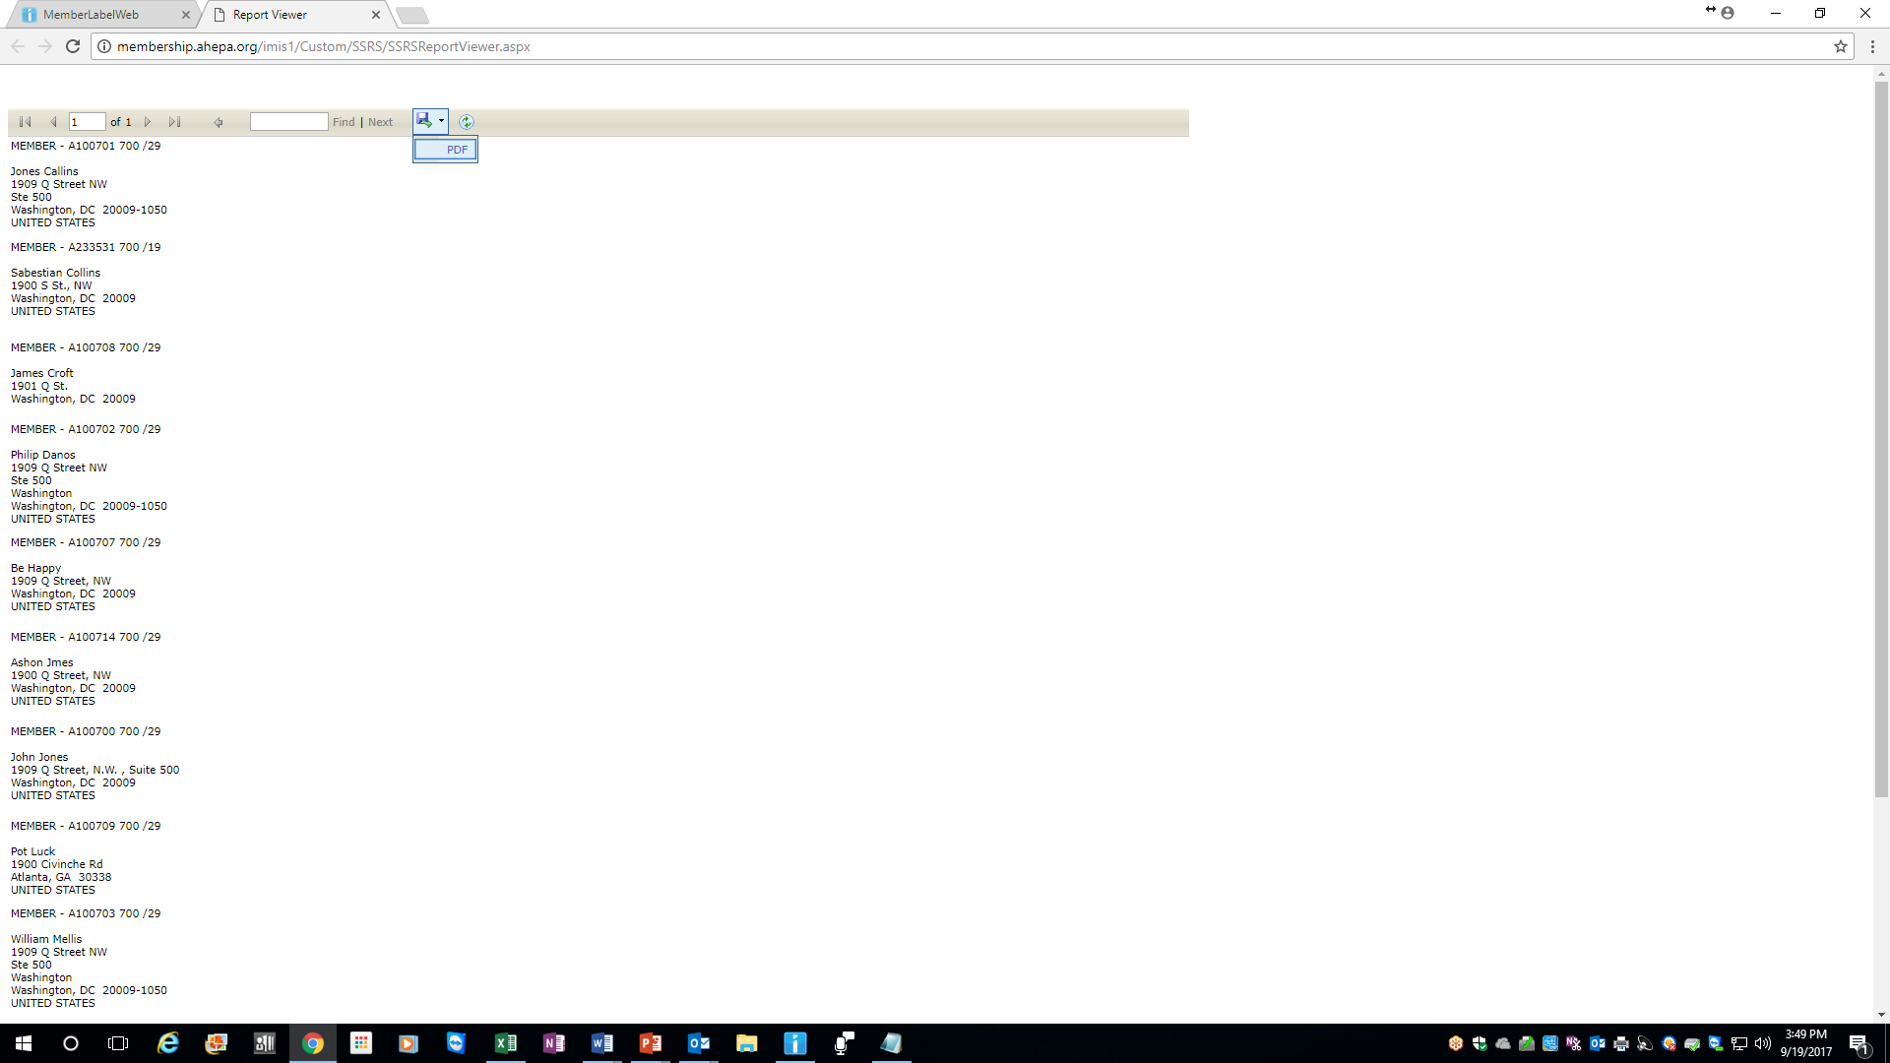
REPORTS DOWNLOAD – MEMBER LABELS
Member Labels
Click Run Report.
Once the labels appear, click on the Save Icon (circled below) and click on the link in order to export the labels to a PDF document or Word.
Insert Avery 5160 or 5960 return labels in your printer tray and print
If printing from Word, go to Page Layout and select 3 columns before printing

Slide 27
General Information
Please feel free to contact headquarters at membership@ahepa.org should you have any questions
Membership website: Go to www.ahepa.org >>click on JOIN>>click on Enter Here
Video tutorial link on how to navigate the site:some features/procedures may have changed or updated since launch of 2016) http://bit.ly/2qvgTF5

